Slide 1

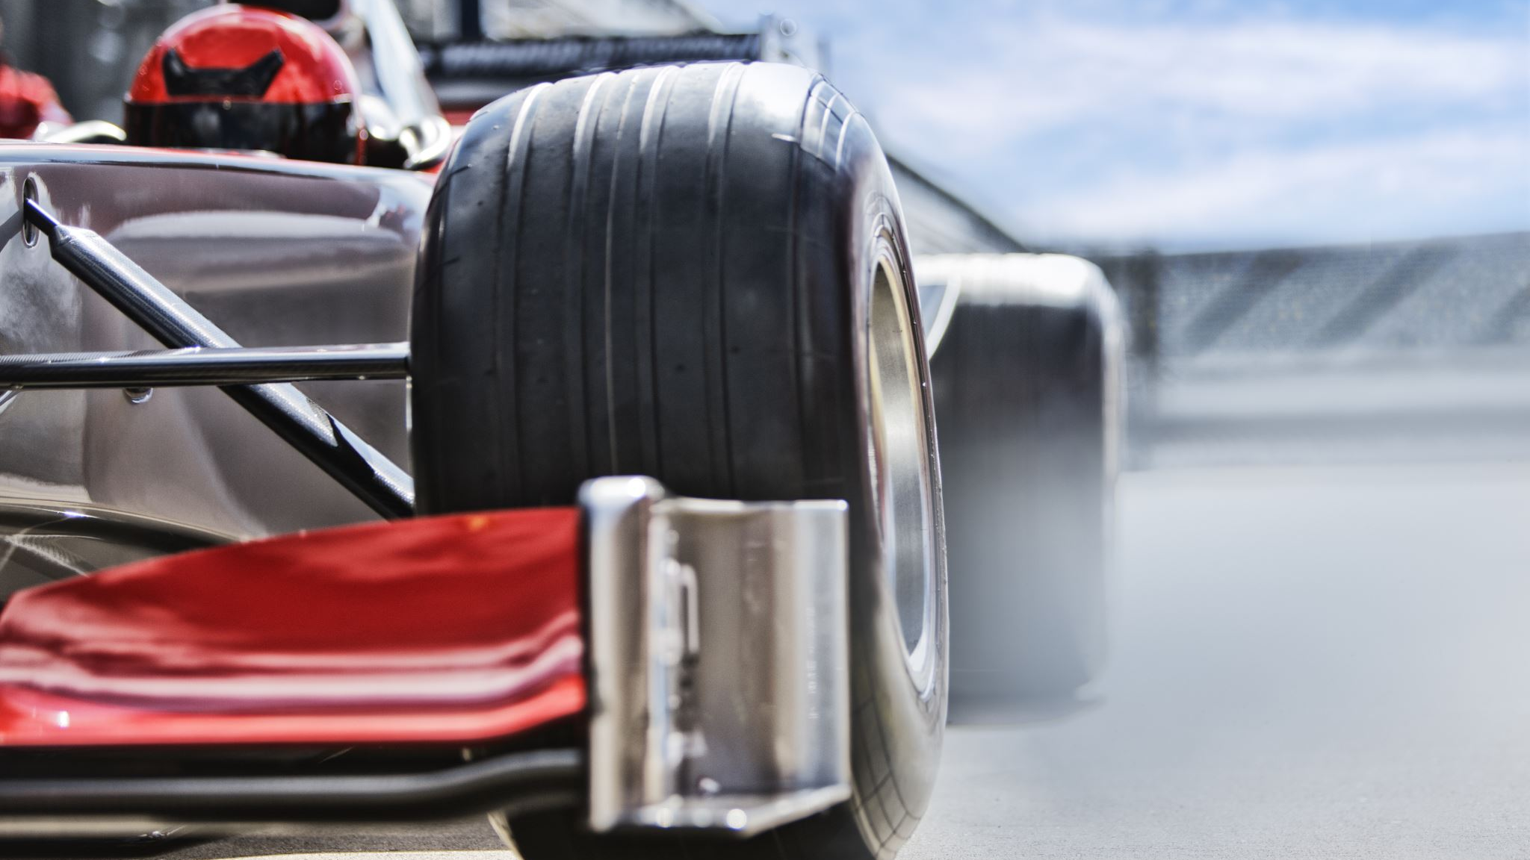
F1-AI Commentary
Kyrian Salas, Felix Van Dijk, Ella Pham, Callum Mackenzie, Leo Faircloth

Slide 2

Project Brief and Client
IBM
A world leader in AI and cloud computing. Through our project, IBM is exploring new ways to translate complex F1 Telemetry into meaningful insights and real-time commentary.
Project Overview
Creating an application that displays F1Telemetry, as well as relaying that information to an AI Commentator, mimicking a real race.
Notes:
Talk about hands off client

Slide 3
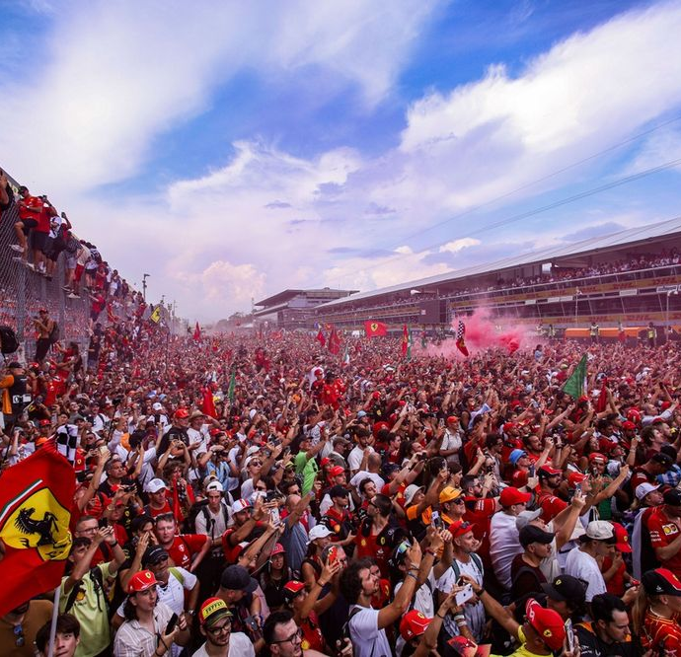
F1 Fans
As a fan, I want to hear live-style AI commentary so that I can relive racing moments and replay my favourite races.

Slide 4
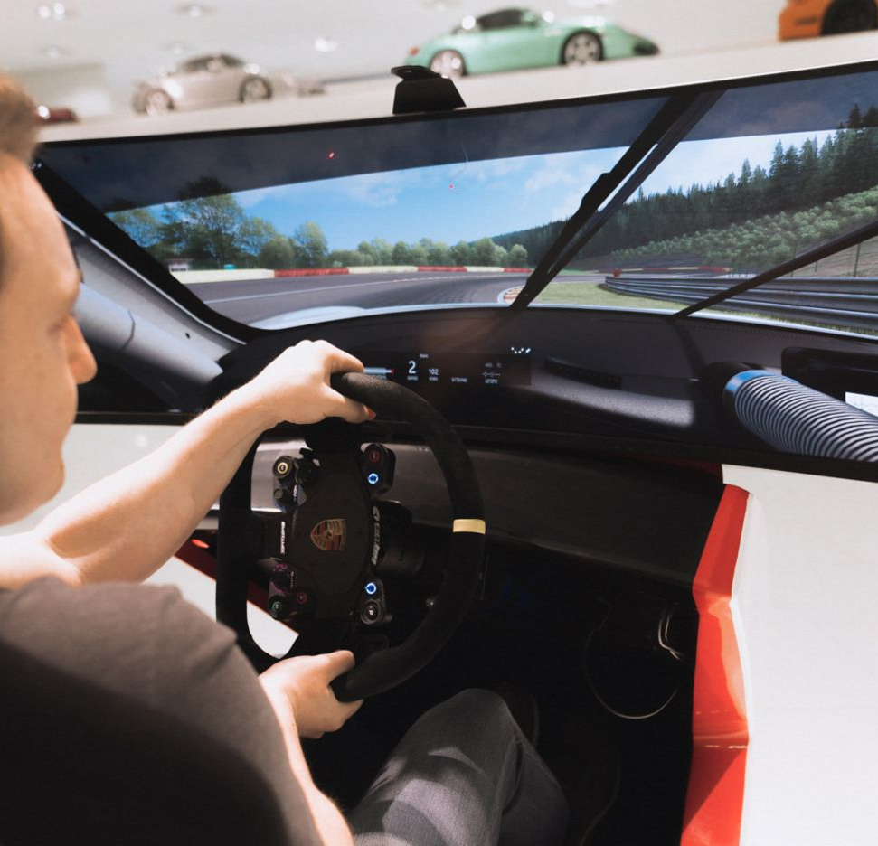
Sim Racers
As a sim racer, I want to analyse my racing performance after a race and see where I can improve.

Slide 5

User Survey
Due to our client being IBM, we had a lot of freedom regarding the choices we can make for this project.
In order to help us make more informed decisions, we developed a survey to help us make better informed decisions.
An in-depth analysis of the results curated from this survey can be found here.
Notes:
Hands off client

Slide 6
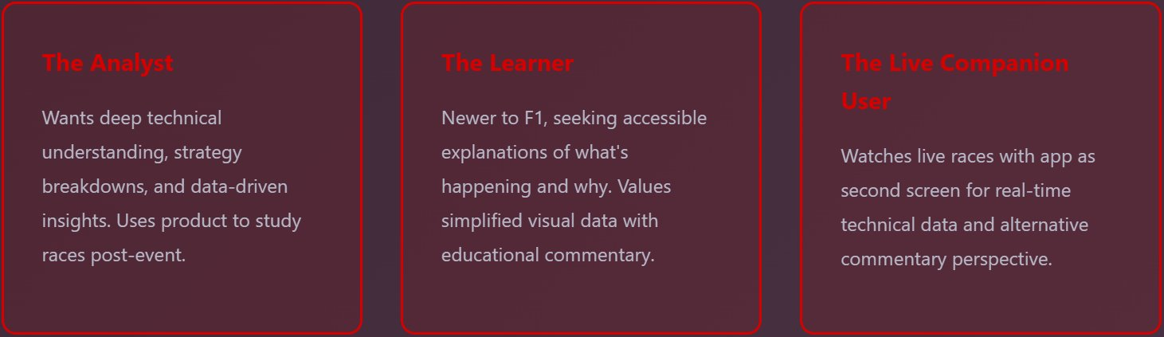
Survey Key Findings
We gained lots of key insights from our survey. The most important of which were the three user profiles we identified:
In future iterations of this project, we aim to implement different 'modes', each of which bespoke and tailored to a specific user profile

Slide 7
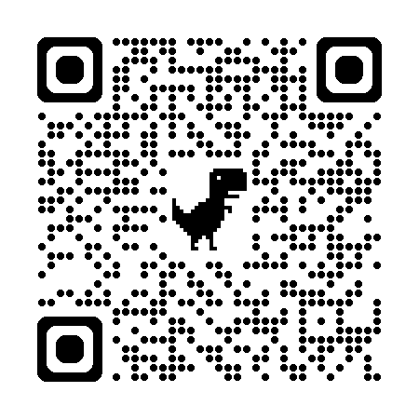
Demo
https://dev.f1aicommentary.co.uk

Slide 8
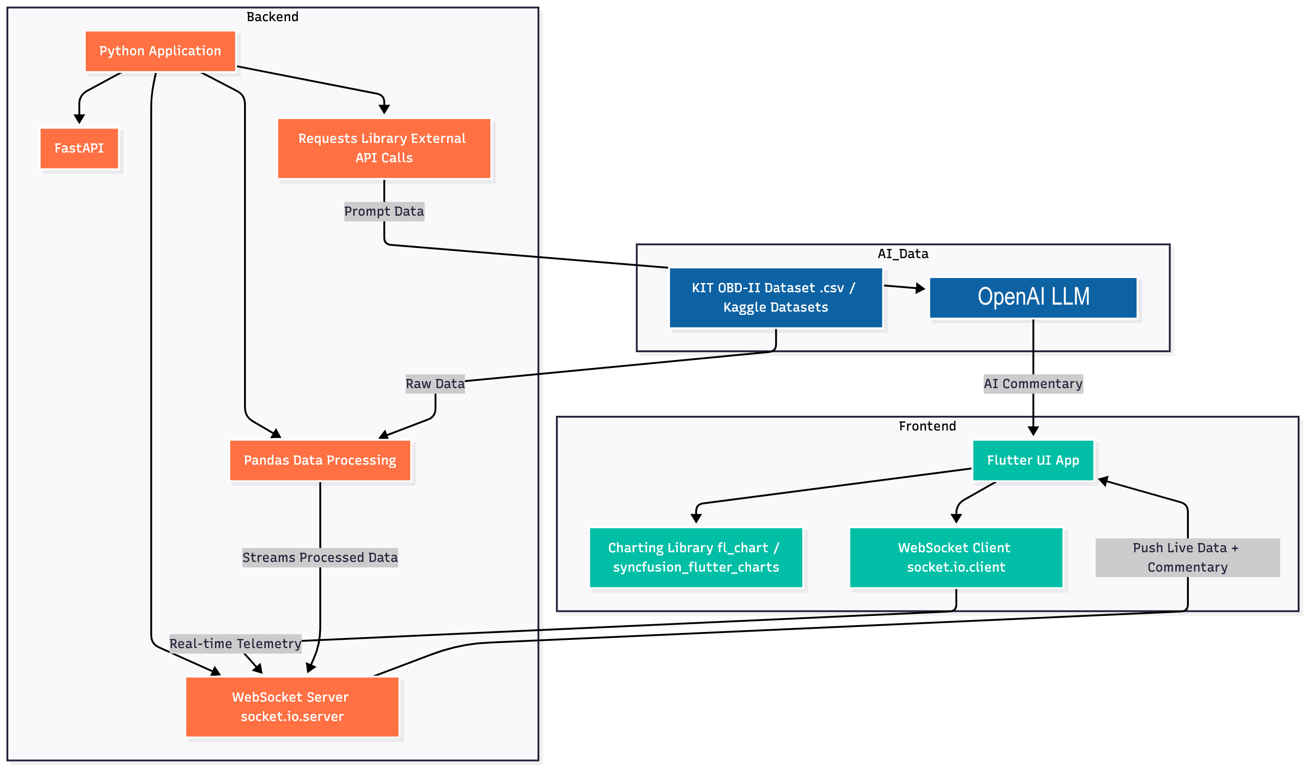
Architecture Diagram and Description
First iteration of our tech stack
Started with using KIT OBD Dataset
Notes:
The goal of the system is to process vehicle telemetry data from the Kit OBD database, analyse it using OpenAI LLM, and stream the results live to a mobile app dashboard made with flutter
Our frontend is built with Flutter and connects to the backend using a WebSocket client
The backend pushes live telemetry data and AI commentary.
The Flutter app displays the data using interactive charts and visualizations.

Slide 9

Updated Tech Stack
Now integrated with telemetry pulled from Assetto Corsa and Fast F1 historic data.
FastF1/CSV Telemetry
Notes:
Decided we wanted to integrate real telemetry. Callum – asetto – telemetry into csv – fastf1 for historic data

Slide 10


CI/CD
Implemented continuous deployment
Backend: Docker image built and uploaded to GitHub Container Registry, then deployed to EC2 via SSH
Frontend: Flutter web app built with dynamic API URL's and deployed to EC2 via SSH
Automated workflows trigger on push to main/dev branches or manual dispatch
Uses GitHub Actions for CI/CD pipeline
Ensures updated Docker containers and web assets on an EC2 instance.
Used CertBot for SSL certification.

Slide 11
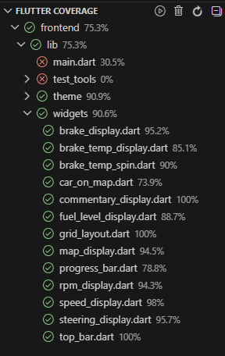
Frontend Test Coverage – 75.3%

Slide 12
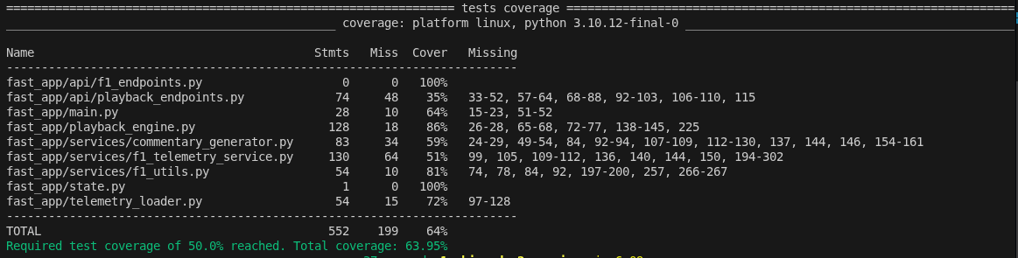
Backend Test Coverage – 64 %

Slide 13

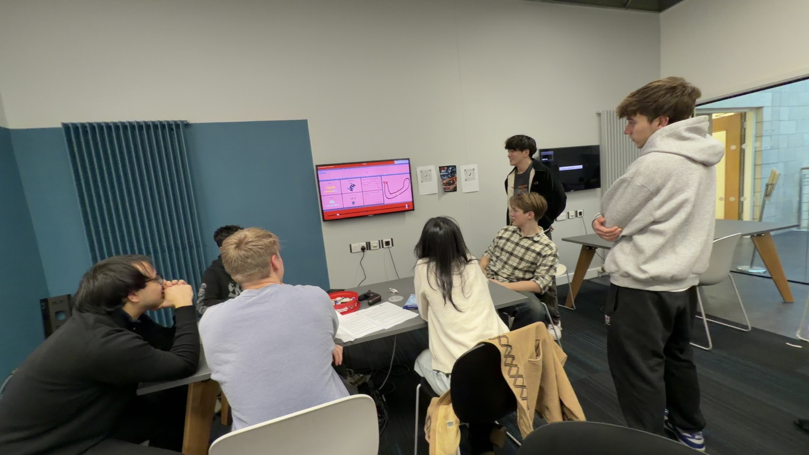
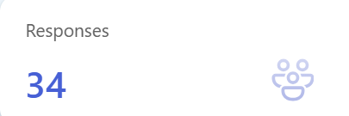
SEP testing day

Slide 14
User Testing
Average SUS Score:
60.15/100
Grade C
 | Testing Day 1 | Testing Day 2
Likes | Processing own data Liked data available 91% thought easy to use | UI Visualises data well
Improvements | UI More widgets | Wider variety of stats More enthusiastic voice More cars

Slide 15
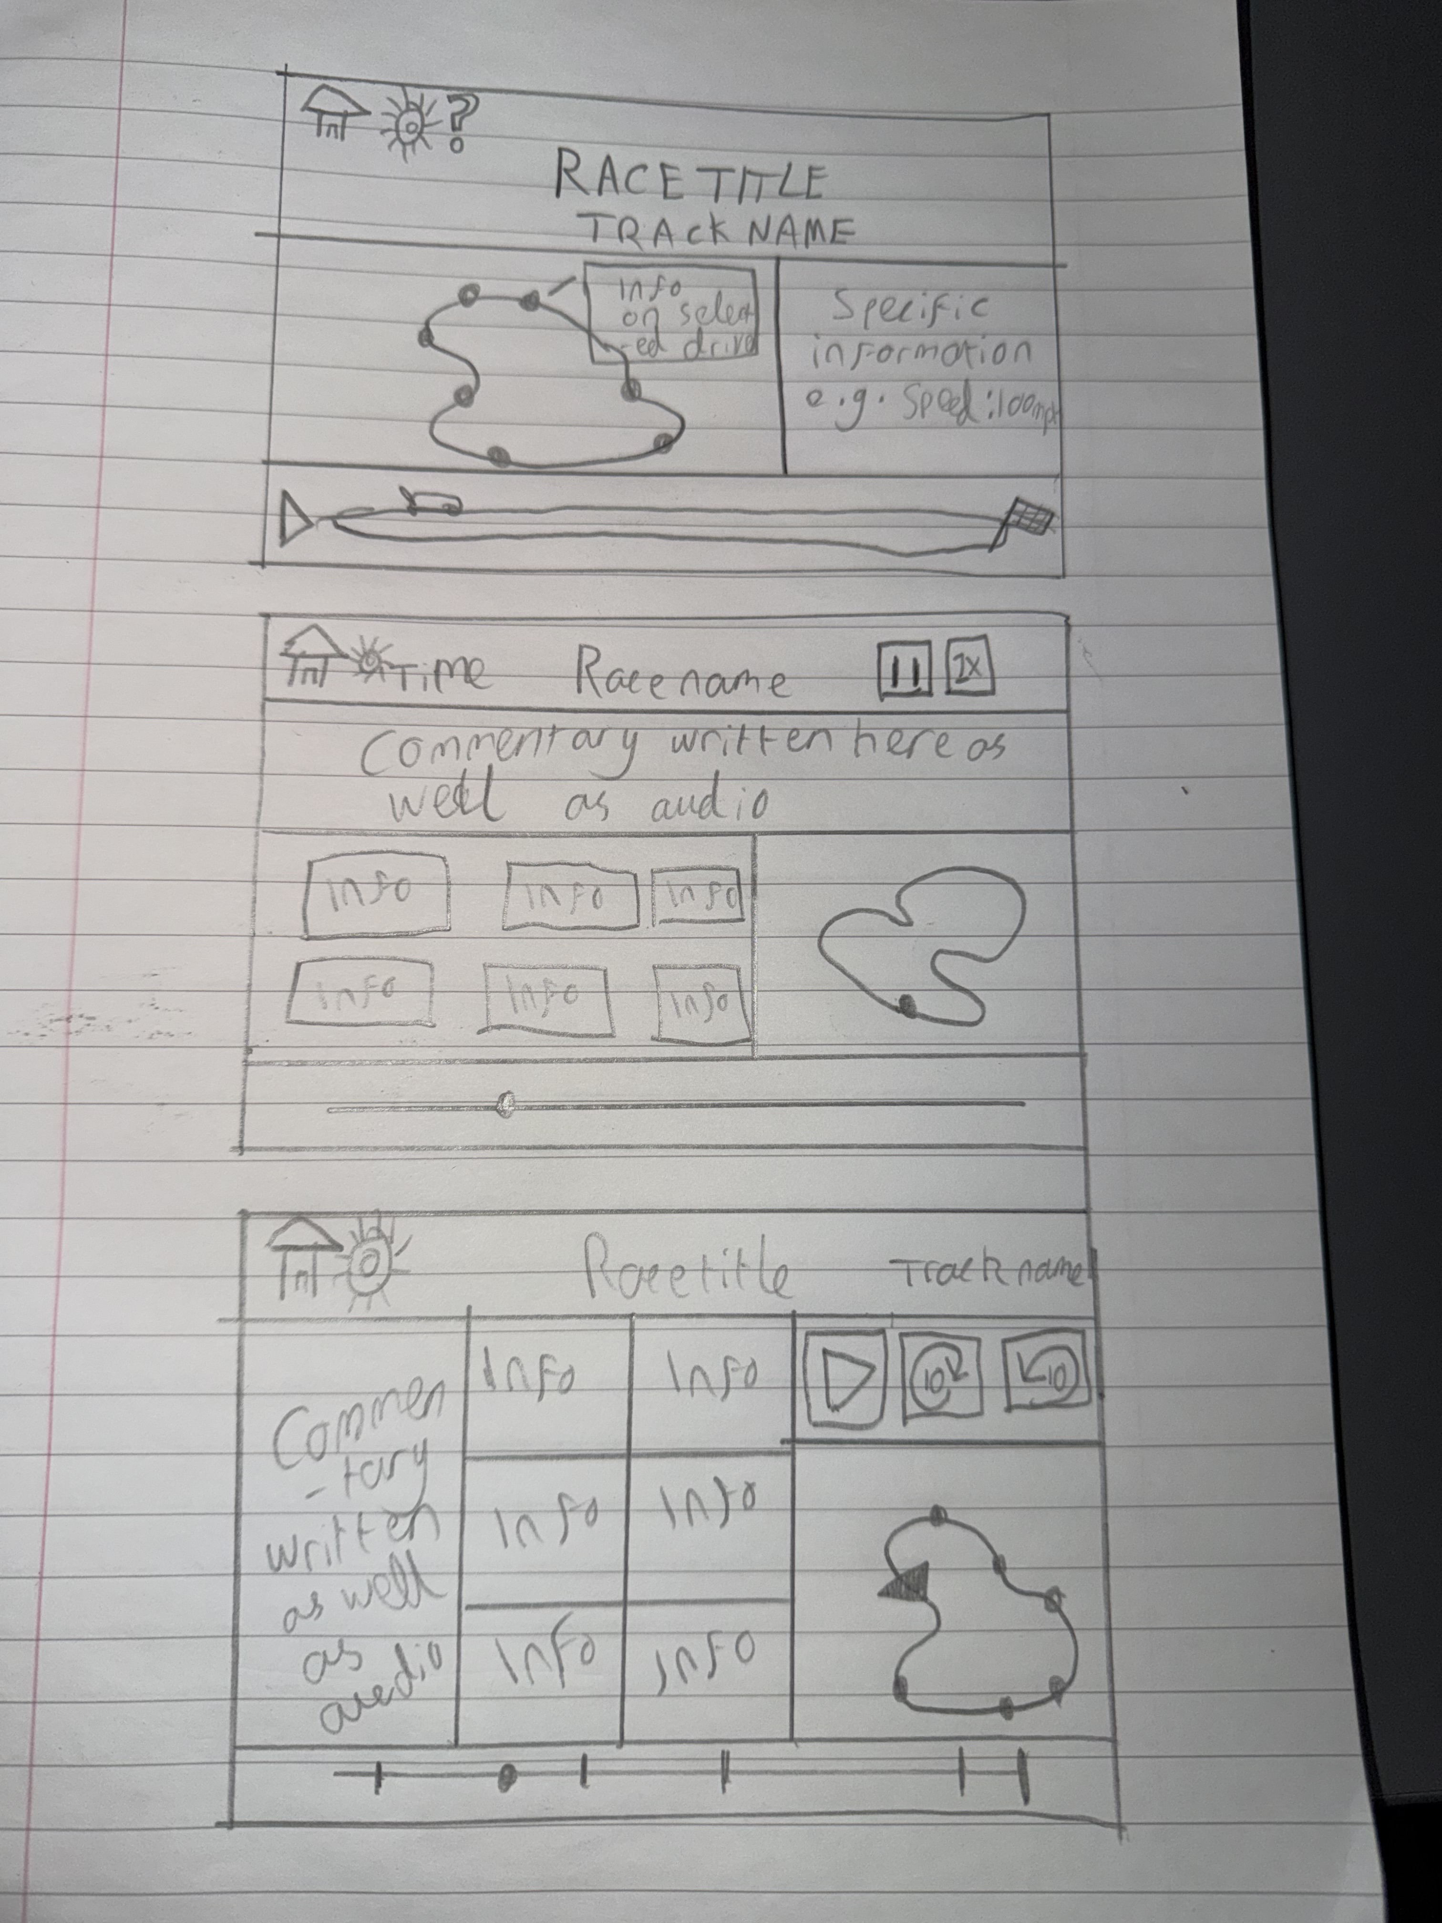
TESTING DAY 1 CHANGES
From testing day 1 we concluded that our most pressing issue with the UI. We decided to do a sprint from testing day to beta in order to resolve this issue.
Notes:
1) AI made example, made very quickly using AI just to
demonstrate what the project could look like
2) MVP user interface, largely using pixel art, less intricate with
information given.
3) Beta user interface, modernised largely from what user testing
Requested I think this should be less text just images
Our approach has evolved from being client focused, into being
stakeholder focused, as we do not receive much feedback from our
client, we now ensure we meet their requirements, but to evolve our
UI we take input from user testing, and our own extensive usage and
implement new features from that.

Slide 16
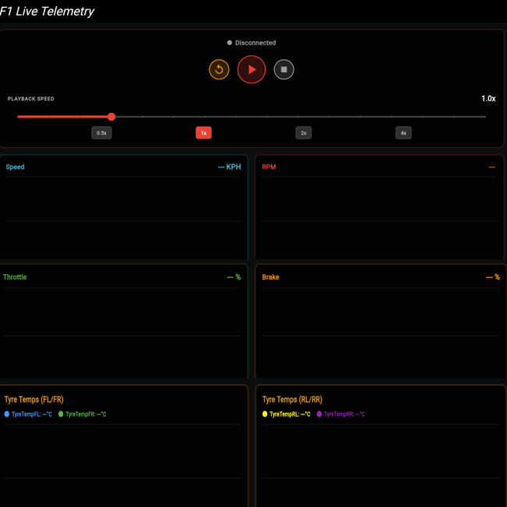
AI Prototype mock-up

Slide 17
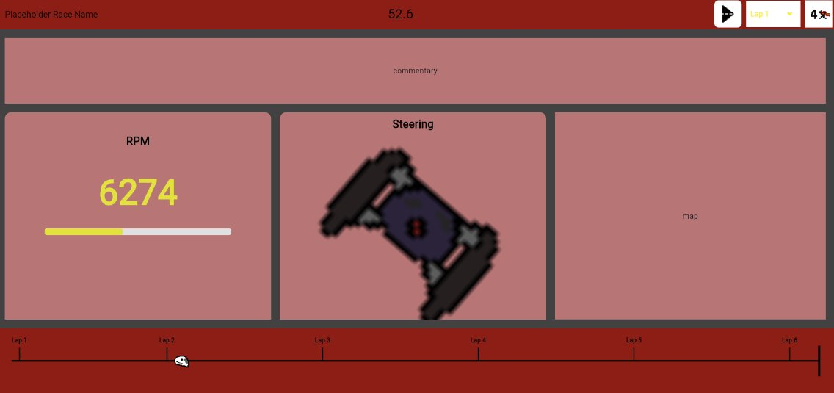
Pre testing day
Time elapsed
Lap #
Play/Pause
Playback speed
Time elapsed
Progress bar
Wheel angle

Slide 18
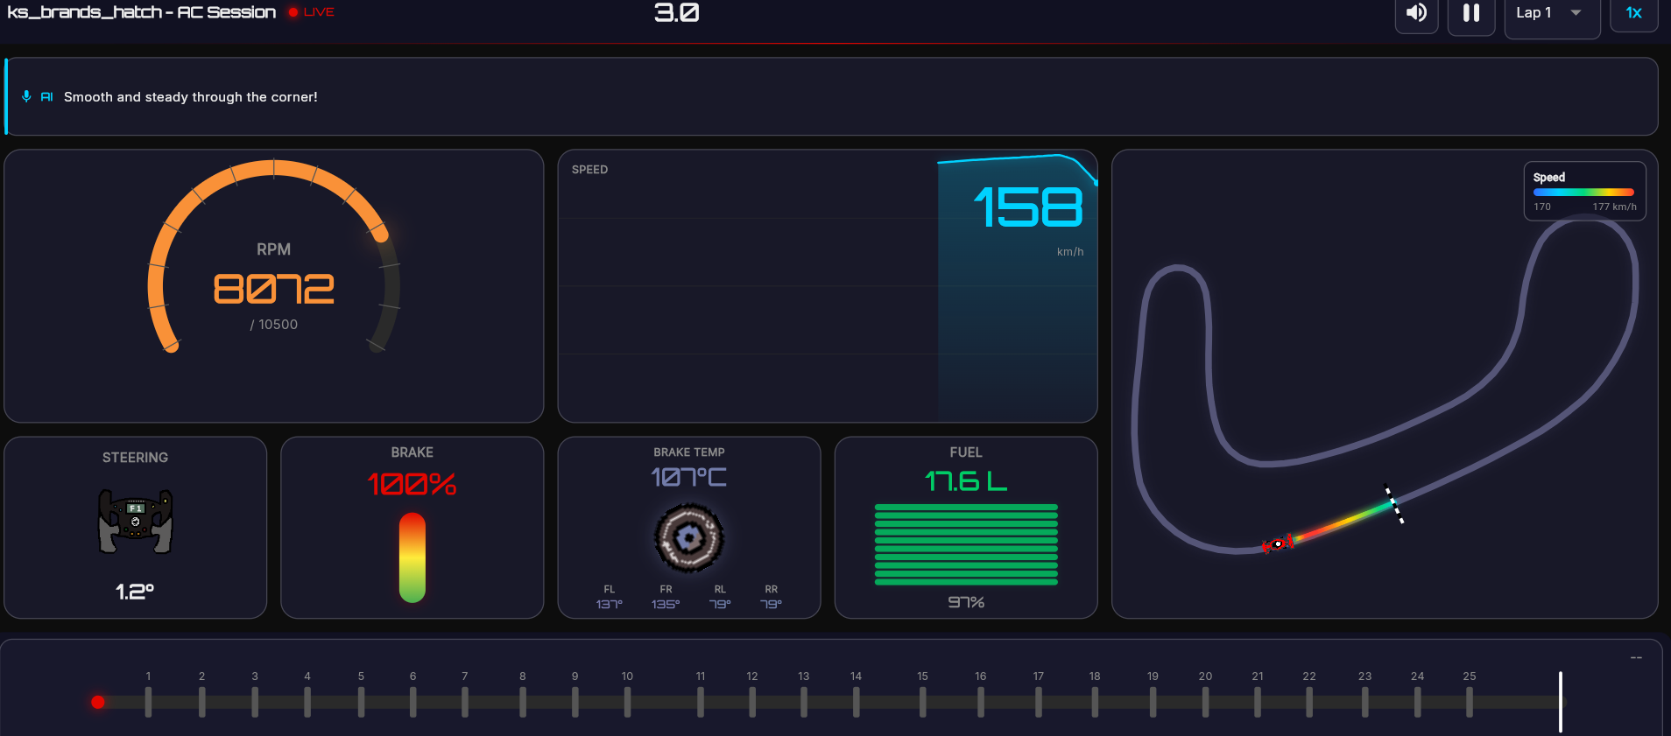
Post testing day
Elapsed time
Mute
Lap # selector
AI generated commentary
Speed
Play/Pause
Rev Counter
Playback speed
Key:
-Improvements
-Additions
-No change
Wheel angle
Brake %
Break temp
Fuel gauge
Heatmap
Progress bar

Slide 19
TESTING DAY 2 CHANGES
Positives:
Users liked the new UI
Issues:
Lack of cars
AI voice
Resolutions (before final):
Utilise FastF1 to fetch data on additional cars
Experiment with more in depth AI prompts and different voice types

Slide 20
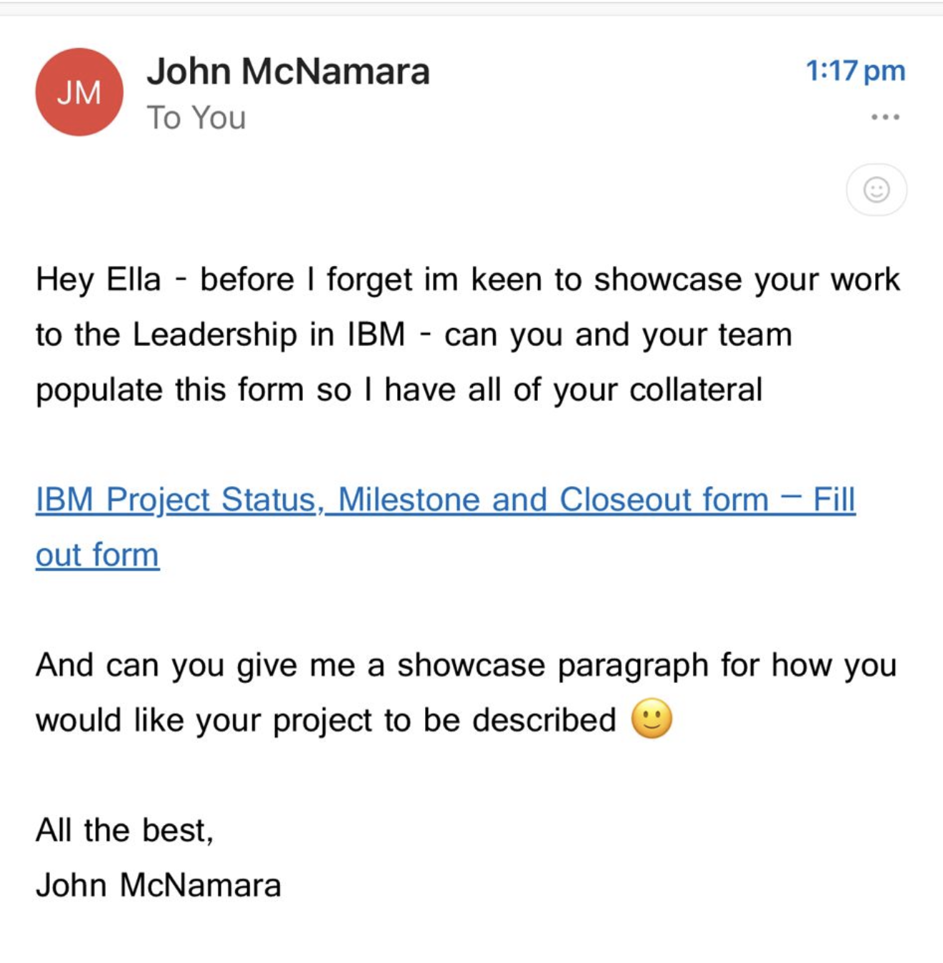
Client Feedback
Our client feedback is somewhat ambiguous and uninformative but seems positive which makes us hopeful!

Slide 21
Our process
Weekly Meetings:
We met every week on Friday afternoon with other meetings scheduled as necessary. This allowed us to check progress and delegate tasks. We also used this time to choose this weeks project manager
Teams:
We utilised teams and channels without our team to separate and compartmentalise our work. This ensured everyone knew what to work on, and everything was organised
Agile Workflow:
We ensured to separate large jobs into smaller manageable tasks, then organising these into regular sprints
Meeting Mins:
During the latter half of the project, we started writing meeting mins to keep track of tasks delegated and what we discussed. This helped keep us on track
GitHub:
We implemented templates early, ensured a detailed kanban at all times, and had detailed discussions within PRs

Slide 22
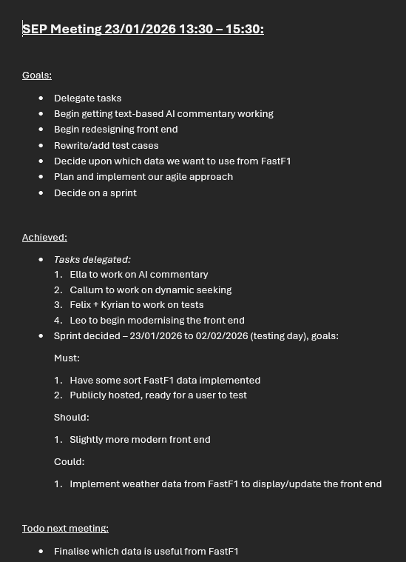
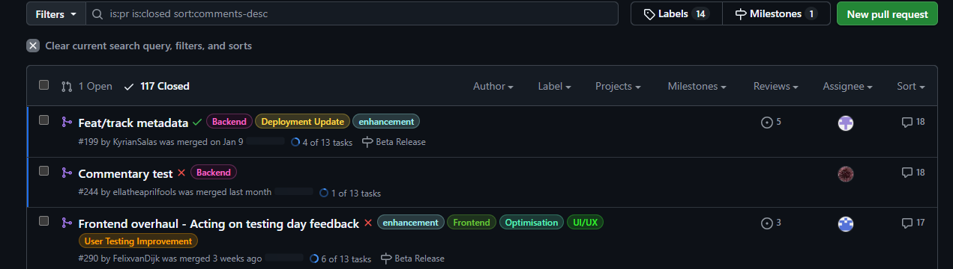
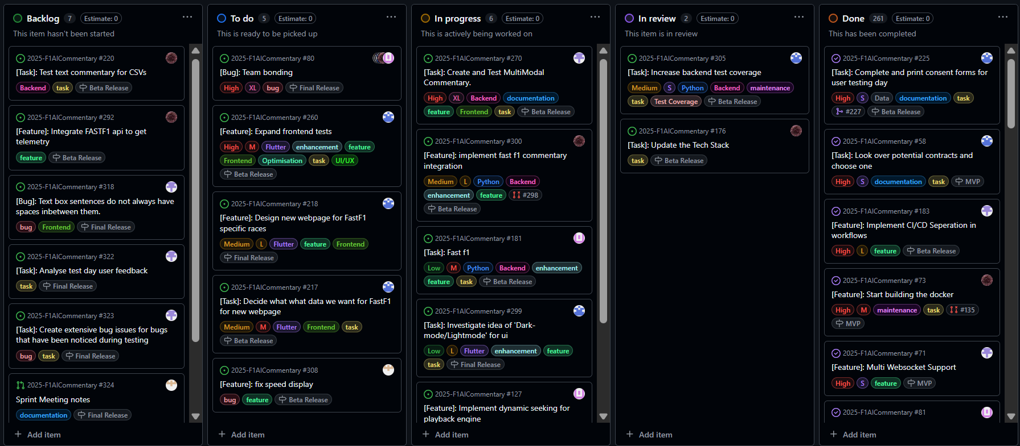
Project Management

Slide 23
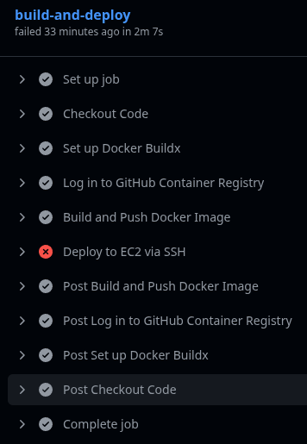
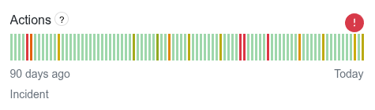
Technical Challenges
Writing in a new language (Dart)
Using AWS
Rewriting code for modularity
GitHub actions going down
Widget sizing on phones (testing day)

Slide 24
Issues We Faced – Project Management
Unequal TB1 Workload
Kanban board not being used effectively
PR content not being discussed within pr's, meaning some details were forgotten.

Slide 25
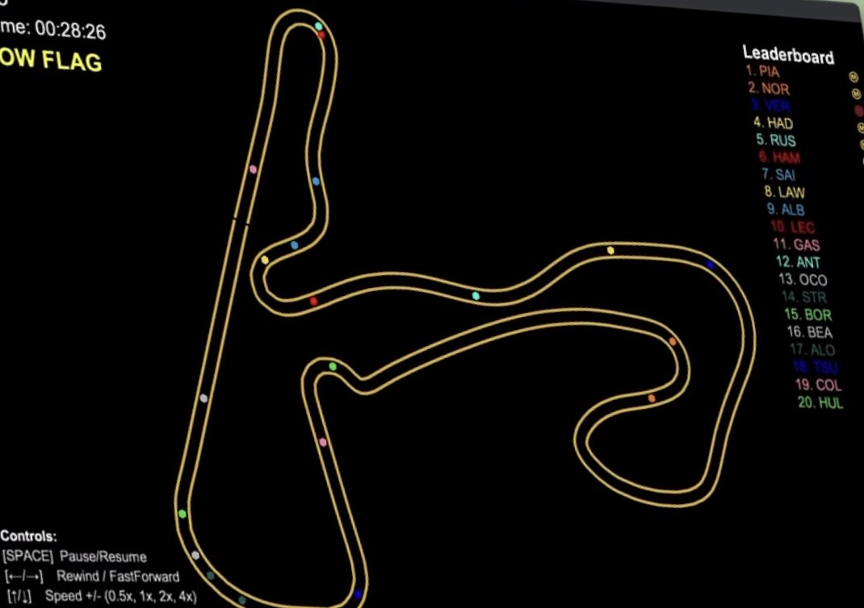
Main Release Roadmap
Multiple cars
Leaderboard
Prototype ElevenLabs voices instead of OpenAI.
Increase code coverage.
FastF1 Integration
Allow users to upload their own race data
Event Indicator

Slide 26
Questions?
Thank you!

